Slide 1
Molecular Dynamics E7 Final Project
Ihsan Ah, Kaleb Savage, Liam Webster, Ning Pichitsurakij,
Tan Triyanond, Tomo Yoshino, Yenvy Nguyen
Professor Shaofan Li

Slide 2
Background Information
Simulation
Describes atoms’ trajectory for a given time interval
Predict particles’ location and allow us to study force interactions between atoms
Applications: drugs and protein interactions, atomic structure prediction, polymer crystallization

Slide 3
Project Description
Goal
Design and code a molecular dynamics simulation via MatLab
Demonstrate how programming can integrate concepts and mathematical expressions to create useful tools for scientists and engineers
Molecular Dynamics Simulation
Composed of 32 uncharged particles in a 1x1 box
Animation of the trajectory of each particle
Graphs of average kinetic energy, potential energy, temperature, and pressure variation
Lennard-Jones potential plot
Functions
Composed of 6 MatLab files: “main.m”, “MD.m”, “LJ_plot.m”, “compute_force.m”, “Calculate_Temperature.m”, and “animation.m”

Slide 4
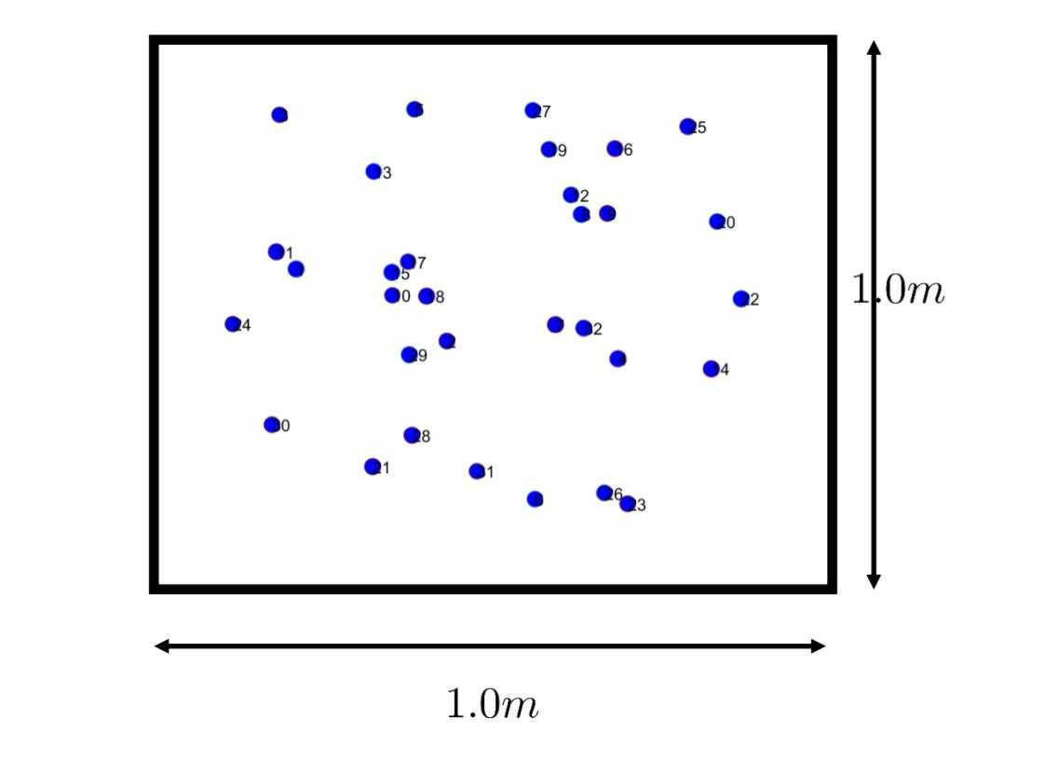
Main Function (Theory)
Initializes the parameter necessary to the simulation
Numbers of particles: 32
Dimension: 2
Size of the box: 1.0m x 1.0m
Density = 32 / Box Size
Volume = (Box Size)^(Dimension)
Parameter such as position, force, temperature, etc follows other m scripts.

Slide 5
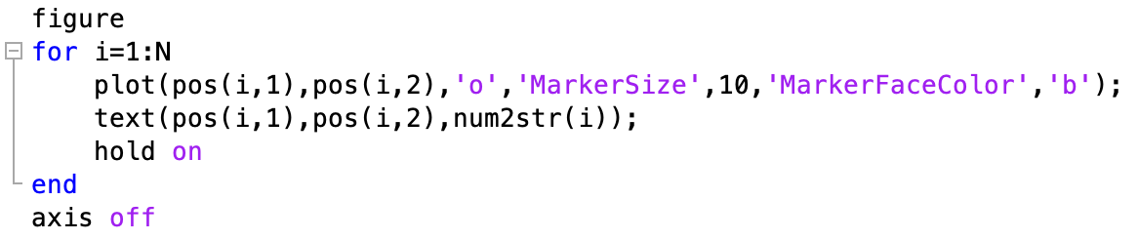
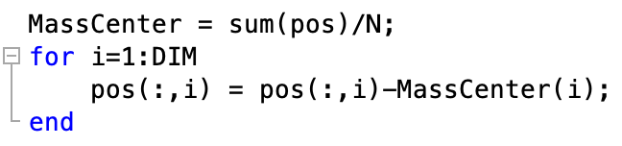
Main Function (Technical)
Create a 2D environment for molecular dynamics simulation
Define dimension of space (DIM), length of the sides of space (BoxSize), number of particles (N), density, and other pre-defined constraints.
Position of each particle is loaded from ‘position.dat’ file and scaled to the defined dimension
Center of mass of the particles is calculated to adjust the positions of the particles accordingly using for loop
Positions of the particles are plotted in the 2D space using for loop

Slide 6
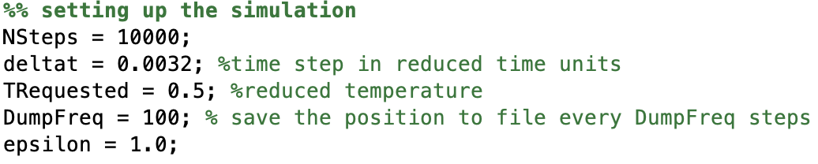
Main Function (Technical)
Initiating the simulation
Defines variables for number of steps before recorded measurements (NSteps), time between each recording steps (deltat), the reduced temperature (TRequested), the frequency at which frames are dumped for animation (DumpFreq), and the dispersion energy (epsilon).
The variables are plugged into MD function to generate animation frames and other outputs, including pressure, temperature, kinetic energy, and potential energy of the system

Slide 7
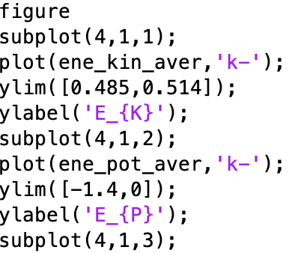
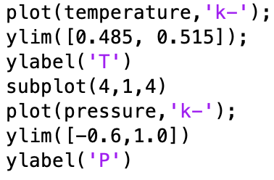
Main Function (Technical)
The generated animation frames are used to create the simulation via ‘animation’ function
Other generated outputs are plotted out

Slide 8

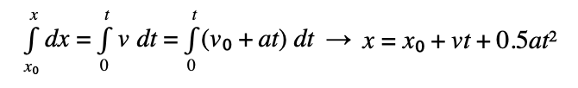
MD Theory
Newton’s second law (F= ma) is used to describe and predict the motion of the particles in molecular dynamics.
Assuming the acceleration is constant (a=dv/dt), expressions of velocity and position of the particles can be derived by performing single and double integrations respectively on the acceleration.

Slide 9


MD Theory
Velocity is directly proportional to the temperature according to the thermal velocity equation
This relationship is also accounted for in calculating the position and the velocity of the particles.
Temperature is also related to pressure according to ideal gas law
Therefore, pressure is also calculated by modifying and applying the ideal gas law.

Slide 10
MD Technical
for loop to calculate energies, Pressure, Temp in all 10,000 frames
Use previous frame’s vel, acc to find next vel and locations
Recalculate velocity several times:
Consider temperature, previous frame’s acceleration, intermolecular forces, new acceleration
Call functions: calculate_temperature and compute_forces
Store every 100th frame as an image

Slide 11
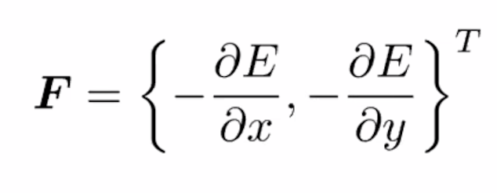
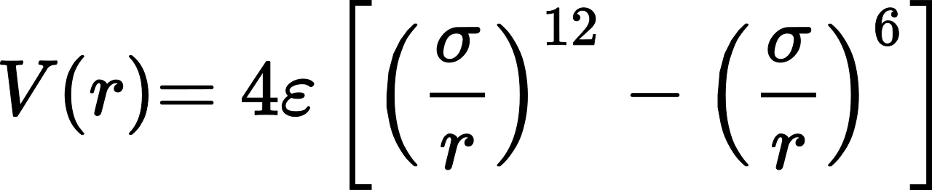
Computing Force Using Lennard-Jones Potential
Two-dimensional force can be calculated with respect to x and y by differentiating the Lennard-Jones potential energy function with respect to distance:
Force*displacement = Work = ΔPE
Force = dW/dx = dV/dr

Slide 12
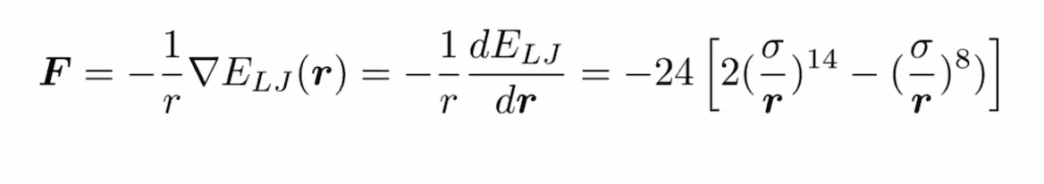
Computing Force Using Lennard-Jones Potential
In the differentiated Lennard-Jones function, ‘r’ is the distance between two particles, ‘σ’ is the Van der Waals radius, and ‘ε’ is the energy of minimum interaction.

Slide 13
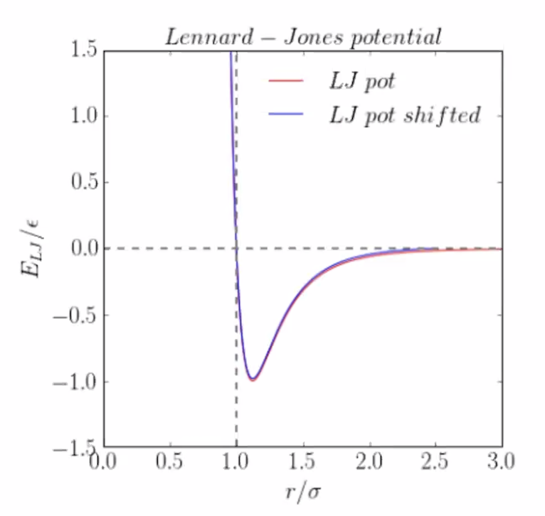
Computing Force Using Lennard-Jones Potential
When particles begin to overlap (ie. r/σ<1), potential energy is increasingly positive and repulsive
When particles reach an equilibrium (r/σ=1), potential energy is 0
When distance between particles increase (r/σ>1), potential energy is negative (attraction) and increases until increasing distance makes energy negligible (converges to 0)
Cutoff is given at r/σ=2.5 because of negligible energy
Graph is shifted to accommodate for unrealistic jump in energy after the cutoff

Slide 14
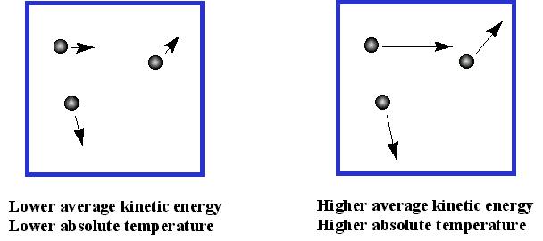
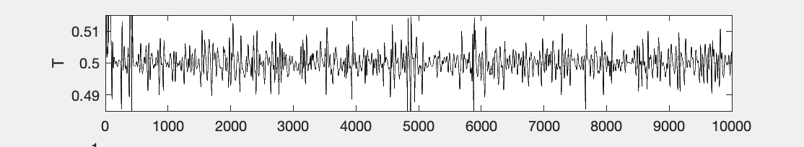
Calculate Temperature Theory
The physics behind this function deals with the ideas of kinetic energy and relating it to temperature.
Kinetic Energy- the energy a molecule possess due to its motion.
Every atom as kinetic energy but not every atom has a temperature, temperature is an intuitive tool.
As the overall average kinetic energy of a group of particles increases so does the temperature at a proportional rate.
https://www.mikeblaber.org/oldwine/chm1045/notes/Gases/Kinetic/temper.gif

Slide 15
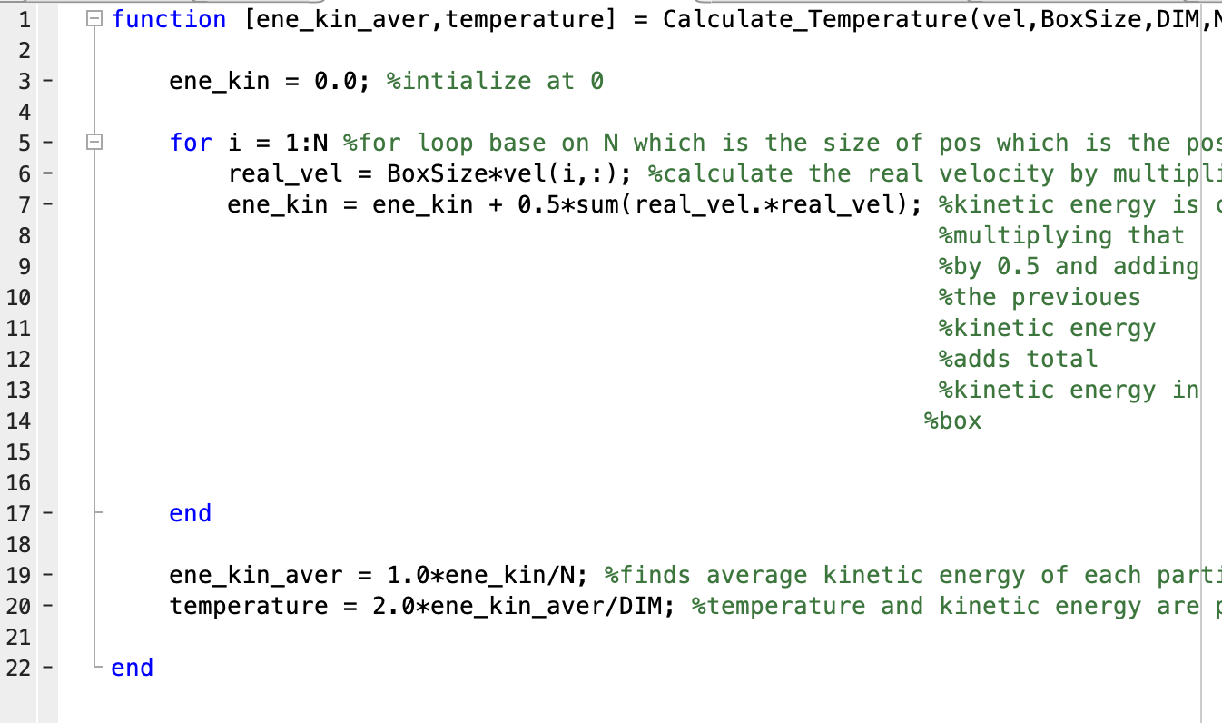
Calculate Temperature Technical
22 lines of code
Utilizes a for loop, that iterates 1 to the number of particles.
Inside of the for loop the kinetic energy of each particle is totaled.
Then the average kinetic energy of each particle is calculated by dividing the total kinetic energy by the number of particles.
KE = 1/2mv^2 = 3/2kT
By calculating a group of particle’s average kinetic energy and thus it’s temperature, one can use the calculated temperature to make far more complex calculation and draw further conclusions about a group of particles physical and chemical properties.

Slide 16
Animation Function
24 lines in total
Consists of 100 images
Images are opened, captured, and saved to a struct array with their corresponding color data and mapping.
Lastly images are compiled and saved as both gif and avi files

Slide 17
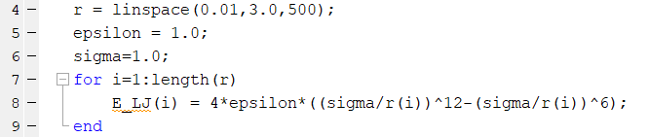

Lennard-jones Potential Plot Technical (Script)
The script begins by using the given values of r, epsilon, and sigma in order to calculate the the Lennard-jones potential energy for each value of r with the following formula (as shown in a previous slide):
The Rcutoff value is then used to determine the Lennard-jones potential when r/𝜎 = Rcutoff. That Lennard-jones potential is subtracted from our original Lennard-jones potential energies to obtain the shifted form of the Lennard-jones potential energies.

Slide 18
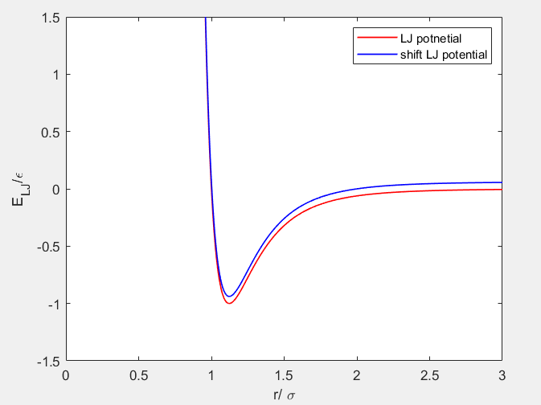
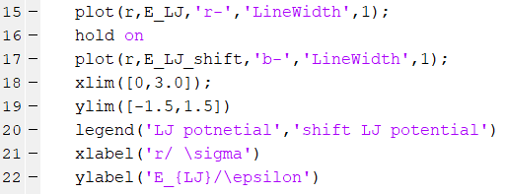
Lennard-jones Potential Plot Technical (Script)
Finally, the calculated Lennard-jones potential energy values (as well as their shifted forms) are plotted with respect to r/𝜎 by using the plot function.

